Slide 1


Advancing Resilience Theory and Tools to Combat Environmental Surprise
David Alderson
Operations Research Department
Center for Infrastructure Defense
Naval Postgraduate School, Monterey, CA
2024 DoD SERDP NICE PROJECT WORKSHOP
25-26 April 2024
Northeastern University, Boston MA
The views expressed here represent the perspective of the authors only and do not necessarily reflect the policy of the Navy or Department of Defense.

Slide 2

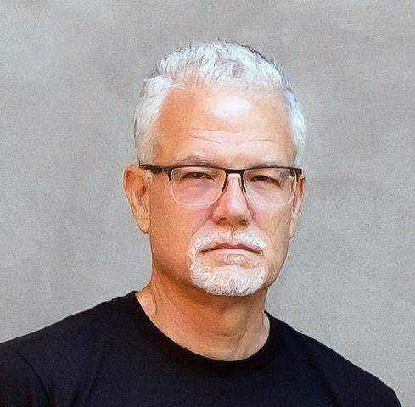
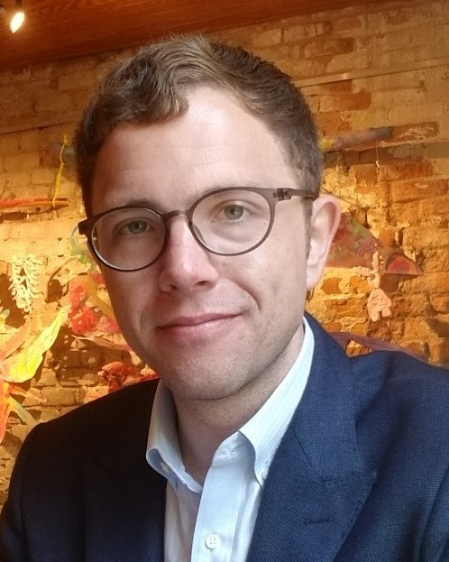
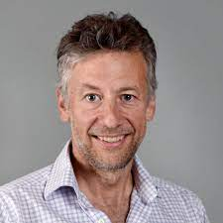


RC21-C2-1233: Advancing Resilience Theory and Tools to Combat Environmental Surprise 2021-2025
Project Team
Dr. David L. Alderson (PI)
Professor, Operations Research, Naval Postgraduate School (NPS)
Director, NPS Center for Infrastructure Defense
Specialist in infrastructure vulnerability, network modeling, and resilience
Dr. Rudolph P. Darken (Co-PI)
Professor, Computer Science, NPS
Specialist in human systems, training and simulation, and critical infrastructure
Dr. Daniel Eisenberg (Co-PI)
Assistant Professor, Operations Research, NPS
Deputy Director, NPS Center for Infrastructure Defense
Specialist in infrastructure vulnerability, system modeling, and resilience
Dr. Thomas P. Seager (Co-PI)
Associate Professor, School of Sustainable Engineering, Arizona State Univ.
Specialist in systems models, simulations, and games for education and training
Dr. Emily Pesicka (Postdoc), Elle Hancock, NPS Officer-Students
Project
Timeline
MAY’21
APR’24
Year 1
Year 2
Year 3
Year 4
2

Slide 3
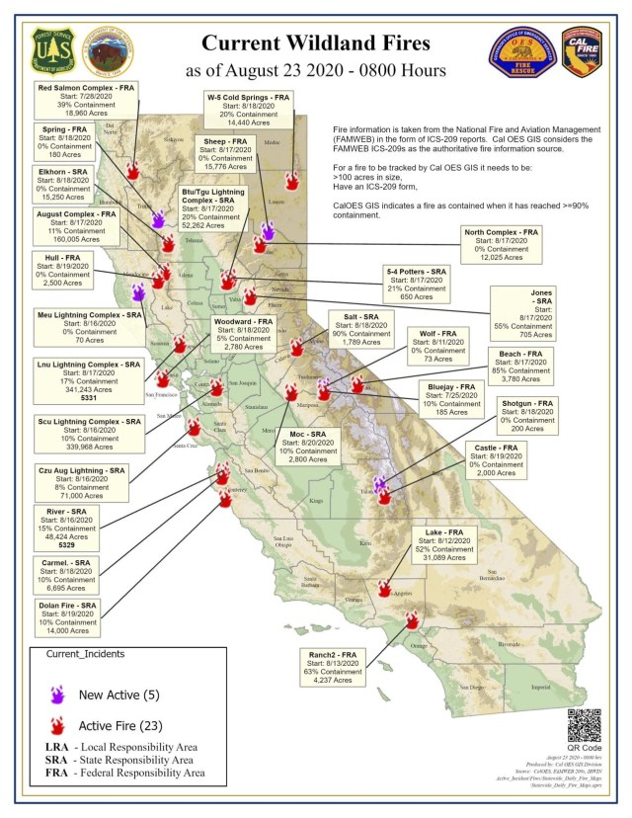
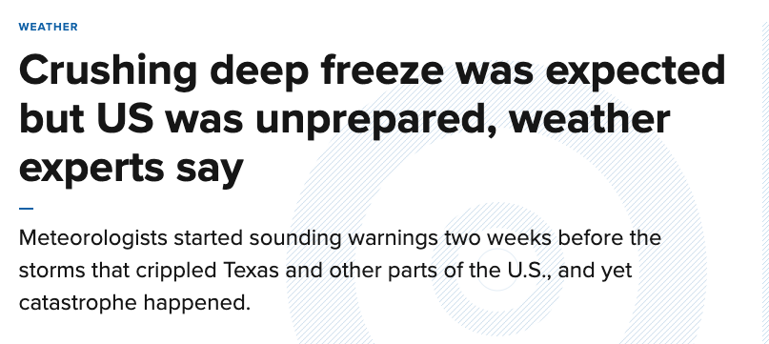
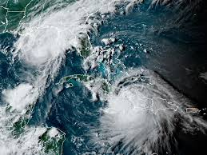
We are living in a world of [climate-driven] surprise.
Colder Deep Freeze?
Simultaneous Hurricanes?
TS Marco
TS Laura
Feb. 19, 2021: This week’s killer freeze in the U.S. was no surprise. Government and private meteorologists saw it coming, some nearly three weeks in advance. They started sounding warnings two weeks ahead of time. They talked to officials. They issued blunt warnings through social media.
And yet catastrophe happened. At least 20 people have died and 4 million homes at some point lost power, heat or water.
By Seth Borenstein, Associated Press Science Writer
August 23, 2020: "The temporal proximity and the geographic proximity of these storms pose a challenge that, quite frankly, we've not seen before," [Louisiana Governor] Edwards said Sunday. "As a result, we don't know exactly what to expect," he said, warning it's a "very serious situation."
https://www.npr.org/2020/08/23/905231988/louisiana-braces-for-one-two-punch-of-storms-as-marco-and-laura-approach-shore
More Destructive Fires?
Aug. 25, 2020: The fiery consequences of extreme heat are not a surprise. In fact, [UCLA researcher Daniel] Swain co-authored a paper that came out just last week with a remarkably prescient and straightforward title: “Climate change is increasing the likelihood of extreme autumn wildfire conditions across California.” The timing is a shock, however, since autumn is still a month away.
https://www.mercurynews.com/2020/08/25/californias-climate-tinderbox-a-scientist-explains-the-fire-crisis/
“Stationarity is dead.”
Milly, P., Julio, B., Malin, F., Robert, M., Zbigniew, W., Dennis, P., Ronald, J., 2007. Stationarity is dead. Ground Water News & Views 4, 6–8.
3
Notes:
The performance of every infrastructure system is limited by interactions within and across its technological and organizational systems that dictate its operational boundary (design envelope)
The actual performance of the system will turn out differently than the specified design
“work as performed” versus “work as imagined”
The specified design and operating plan will become stale over time
our understanding of our systems will become inaccurate

Slide 4
An escalating number of disasters and costs since 2000
NOAA National Centers for Environmental Information (NCEI) U.S. Billion-Dollar Weather and Climate Disasters (2023).
https://www.ncei.noaa.gov/access/billions/, DOI: 10.25921/stkw-7w73

Slide 5
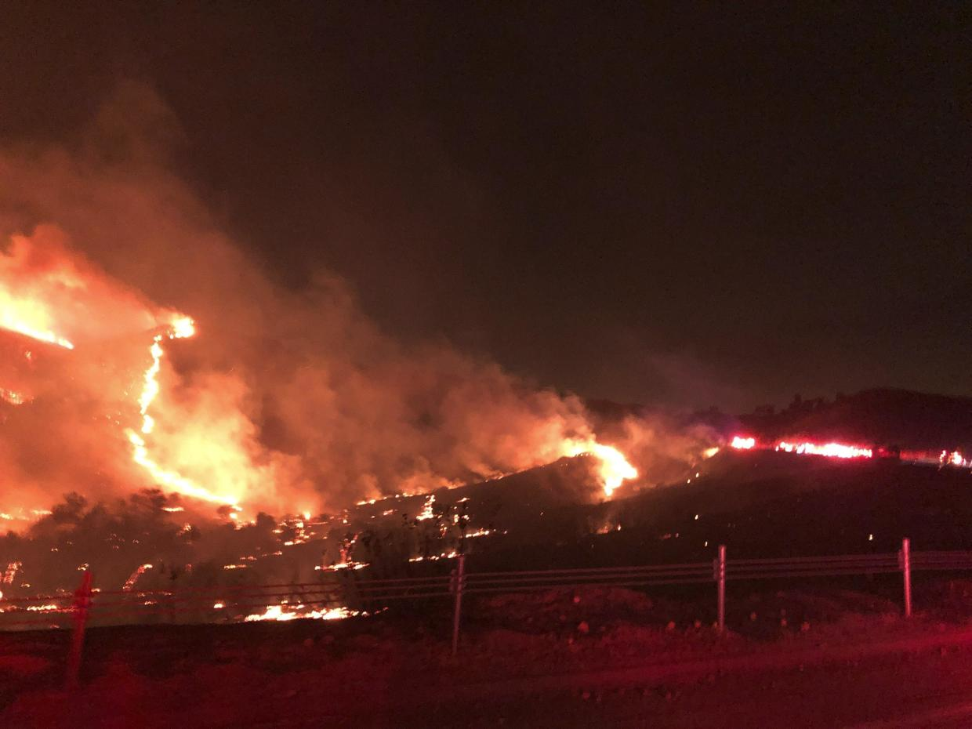
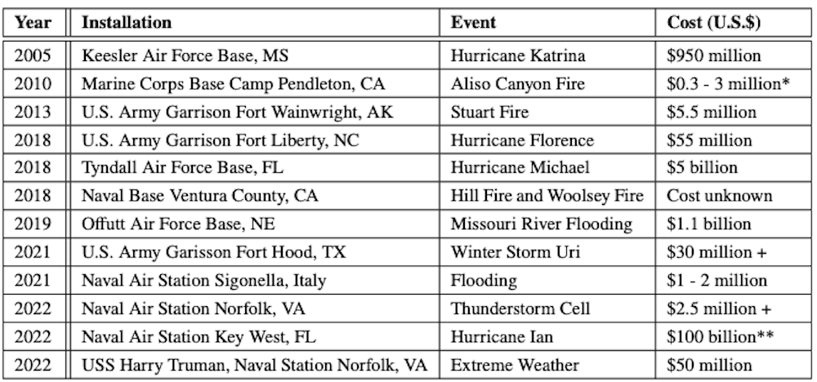
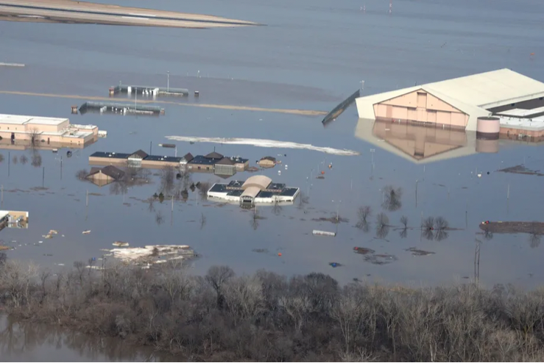
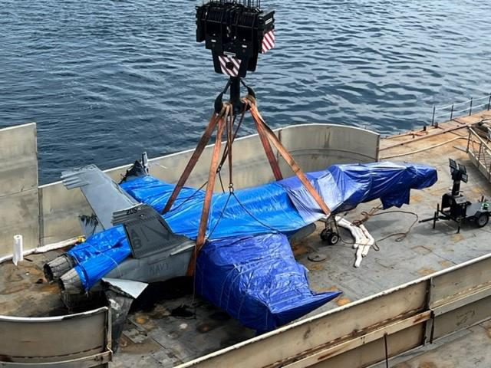
Climate-driven events challenge military installations
Reference: Pesicka E, Eisenberg DA, Alderson DL, 2024, Installation Resilience to Weather Extremes and Climate Change: Learning from Recent Surprises, Naval Postgraduate School Technical Report NPS-OR-23-015, April.
5

Slide 6
Climate-driven events challenge military installations
Many folks think climate change is a distant threat, but it is happening now.
Concern for military operations and readiness is often focused on military infrastructure, but the consequences of these events often depend on infrastructure outside the fence line.
Because climate-driven disasters occur both inside and outside the fence line, there may be limits for installation commanders on the possible safeguards and controls against these vulnerabilities.
These events provide differing levels of advanced warning (minutes – hours – days) that complicate preparedness and response activities for installation personnel
Complete understanding of these events and their effects is often possible only in hindsight.
It is tempting to think that better forecasting will prevent catastrophic consequences.
But the future is not going to be like the past. Forecasts will be imperfect, and warnings are likely to be incomplete or unavailable.
If surprise is inevitable, how we respond could be as important as how we prepare.
Reference: Pesicka E, Eisenberg DA, Alderson DL, 2024, Installation Resilience to Weather Extremes and Climate Change: Learning from Recent Surprises, Naval Postgraduate School Technical Report NPS-OR-23-015, April.
6

Slide 7
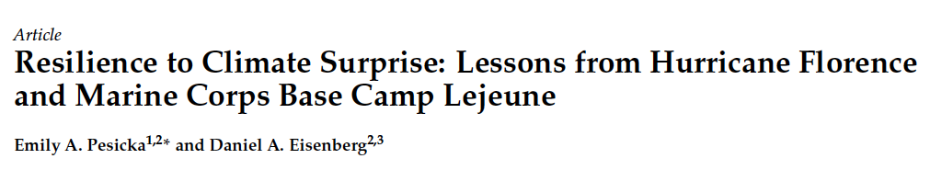
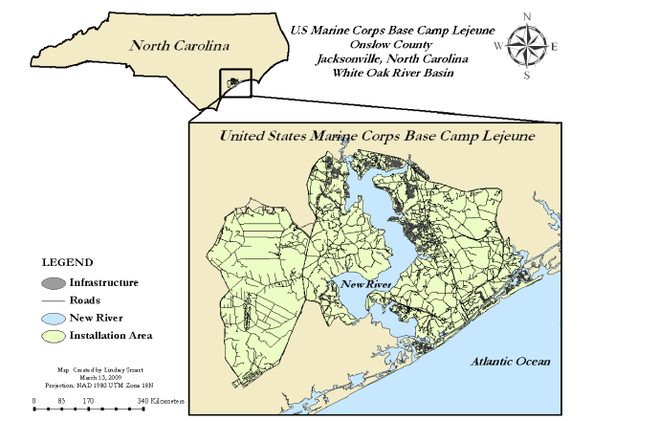
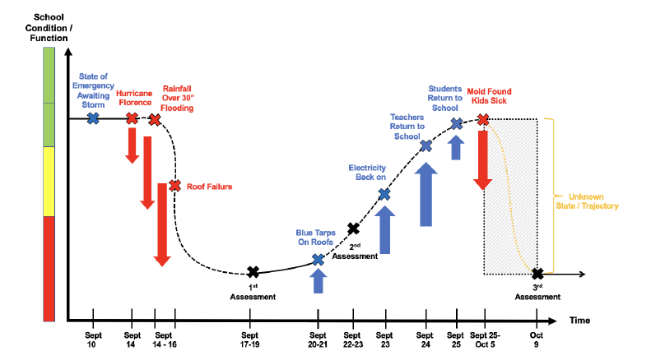
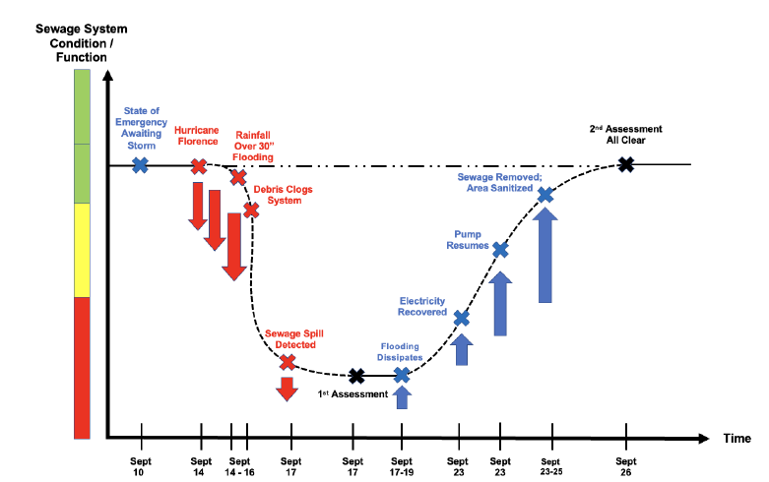
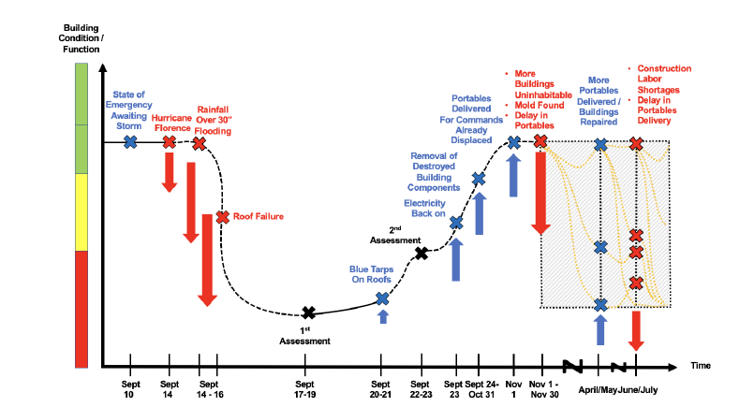
Can we observe these types of surprise-related events on military installations? What are the sources of surprise (in climate-driven events)?
Even in the presence of events that overwhelm us, we expect that recovery efforts will make things better.
Brewster Middle School
But sometimes, we are surprised to learn that our recovery efforts don’t help, or perhaps make things worse.
Portable/
Trailer
Functionality
7

Slide 8
Where does surprise occur for installations?
(1) In our understanding of events that challenge the design boundary of our systems
(2) In the understanding of our systems, how they work, and what they can handle
Why does surprise occur for installations?
It occurs in all systems.
It’s not a failure in our ability to know enough, it’s that things are constantly changing.
Surprise is inevitable
8
Notes:
The performance of every infrastructure system is limited by interactions within and across its technological and organizational systems that dictate its operational boundary (design envelope)
The actual performance of the system will turn out differently than the specified design
“work as performed” versus “work as imagined”
The specified design and operating plan will become stale over time
our understanding of our systems will become inaccurate

Slide 9
Where does surprise occur for installations?
When surprised by extreme events,
how do infrastructure systems handle challenges
that fall outside their design envelope?
Goal: develop new theories along with
novel training techniques, exercises, and experiences
that accelerate development of expertise
for integration of surprise into adaptive response of infrastructure systems and personnel.
(1) In our understanding of events that challenge the design boundary of our systems
(2) In the understanding of our systems, how they work, and what they can handle
Why does surprise occur for installations?
It occurs in all systems.
It’s not a failure in our ability to know enough, it’s that things are constantly changing.
Surprise is inevitable
9
Notes:
The performance of every infrastructure system is limited by interactions within and across its technological and organizational systems that dictate its operational boundary (design envelope)
The actual performance of the system will turn out differently than the specified design
“work as performed” versus “work as imagined”
The specified design and operating plan will become stale over time
our understanding of our systems will become inaccurate

Slide 10
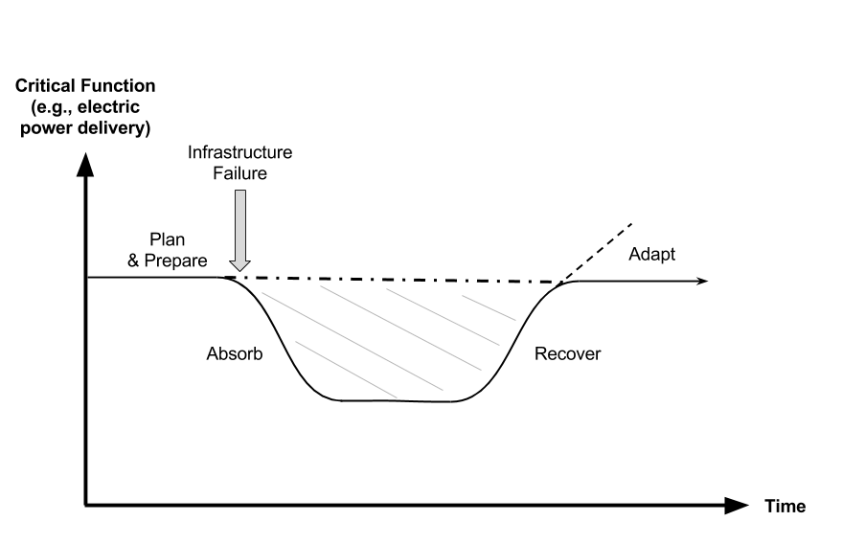
The “Resilience Curve” is a Poor Model of Resilience
Process-Outcome Confusion
Activities? How much effort?
What was helpful?
What could be done better?
Reinforces oversimplifications and misconceptions about resilience
unhelpful for understanding complex systems
potentially dangerous for guiding decisions
The National Academy of Science – “the ability to plan and prepare for, absorb, recover from, and adapt to adverse events.”
10
Notes:
The Technical Background section is where you answer the second question: “What is the scientific basis of your proposed work?” Some of the TRB members may have no background in the work that you are proposing. This section serves two purposes. The first purpose is to provide the TRB with a primer on the science behind your project. This is generally at the Scientific American level of technical detail. Results from previous research that indicate potential for the proposed work should be included in this section.
The second purpose is to assure the TRB that you are familiar with the science. Graphics such as pictures, cartoons, schematics, and graphs are strongly recommended to aid in the TRB’s understanding of your project. This is not the place to give a 30-minute tutorial on the science or your past work.
Number of Slides: 4-8
Time: 6-8 minutes

Slide 11
When surprised by extreme events, how do infrastructure systems handle challenges that fall outside their design envelope?
Brittle
Resilient
Do they saturate and fail?
Do different elements to come together to extend capability in ways that are novel?
Need to focus on Adaptive capacity:
A system’s readiness or potential to change how a system currently works—its models, plans, processes, behaviors, relationships—to continue to fit changing situations, anomalies, and surprises.
A system’s capacity to adapt to challenges ahead, when the exact challenge to be handled cannot be specified completely in advance.
11
Notes:
The Technical Background section is where you answer the second question: “What is the scientific basis of your proposed work?” Some of the TRB members may have no background in the work that you are proposing. This section serves two purposes. The first purpose is to provide the TRB with a primer on the science behind your project. This is generally at the Scientific American level of technical detail. Results from previous research that indicate potential for the proposed work should be included in this section.
The second purpose is to assure the TRB that you are familiar with the science. Graphics such as pictures, cartoons, schematics, and graphs are strongly recommended to aid in the TRB’s understanding of your project. This is not the place to give a 30-minute tutorial on the science or your past work.
Number of Slides: 4-8
Time: 6-8 minutes

Slide 12
When surprised by extreme events, how do infrastructure systems handle challenges that fall outside their design envelope?
Brittle
Resilient
Do they saturate and fail?
Do different elements to come together to extend capability in ways that are novel?
Resilience Processes | Shock (maladaptive) | Resilience (adaptive)
Sensing | Shutdown, numbness, or insensitivity to new information | Open new sensory inputs, reframe existing information
Anticipating | Deny new possibilities, conflating unlikely with impossible | Reveal new possibilities and/or updating probabilistic expectations
Adapting | Recruit additional resources to invest in failing response actions | Reallocate resources based on results of new experiments
Learning | Reinforce misconceptions | Update belief systems
12
Notes:
The Technical Background section is where you answer the second question: “What is the scientific basis of your proposed work?” Some of the TRB members may have no background in the work that you are proposing. This section serves two purposes. The first purpose is to provide the TRB with a primer on the science behind your project. This is generally at the Scientific American level of technical detail. Results from previous research that indicate potential for the proposed work should be included in this section.
The second purpose is to assure the TRB that you are familiar with the science. Graphics such as pictures, cartoons, schematics, and graphs are strongly recommended to aid in the TRB’s understanding of your project. This is not the place to give a 30-minute tutorial on the science or your past work.
Number of Slides: 4-8
Time: 6-8 minutes

Slide 13
Surprise has been studied in a technical way
Cognitive scientists* typically distinguish between three different types of surprise-related events that challenge infrastructure…
Normal variation:
variability in events that fall within the general expectation for normal operation
Situational surprise:
an event that falls outside of normal expectation (extreme or rare), but are still compatible with previous beliefs
Fundamental surprise:
an event that refutes basic beliefs about "how things work" and requires a re-framing on the part of the stakeholders
*For more information: Eisenberg, D.A., Seager, T.P., and Alderson, D.L., 2019, "Rethinking Resilience Analytics," Risk Analysis, 39(9): 1870-1884, DOI:10.1111/risa.13328.
13

Slide 14

Surprise has been studied in a technical way
Cognitive scientists* typically distinguish between three different types of surprise-related events that challenge infrastructure…
A Simple Example
Normal variation:
variability in events that fall within the general expectation for normal operation
Buy a ticket
and win.
Don’t buy a ticket and win.
Situational surprise:
an event that falls outside of normal expectation (extreme or rare), but are still compatible with previous beliefs
Fundamental surprise:
an event that refutes basic beliefs about "how things work" and requires a re-framing on the part of the stakeholders
Buy a ticket
and lose.
*For more information: Eisenberg, D.A., Seager, T.P., and Alderson, D.L., 2019, "Rethinking Resilience Analytics," Risk Analysis, 39(9): 1870-1884, DOI:10.1111/risa.13328.
14

Slide 15
Better prediction (e.g., via AI/ML) will be insufficient!
2019 Risk Analysis 39(9): 1870-1884
15

Slide 16
How to create controlled conditions of surprise?
Models and simulations require relatively little expense,
but they are unable to explore much beyond the normal variation of events that have been conceived in the model.
Reference: Alderson DL, Darken RP, Eisenberg DE, Seager TP, 2022 "Surprise is inevitable: How do we train and prepare to make our critical infrastructure more resilient?," International Journal of Disaster Risk Reduction, 72: 102800, 1 April 2022
16

Slide 17
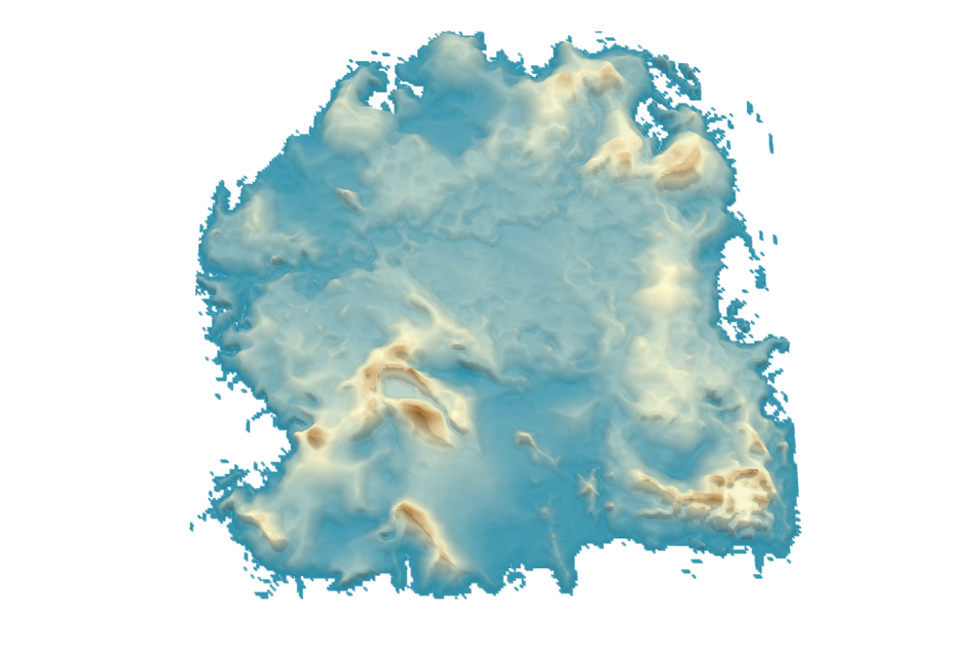
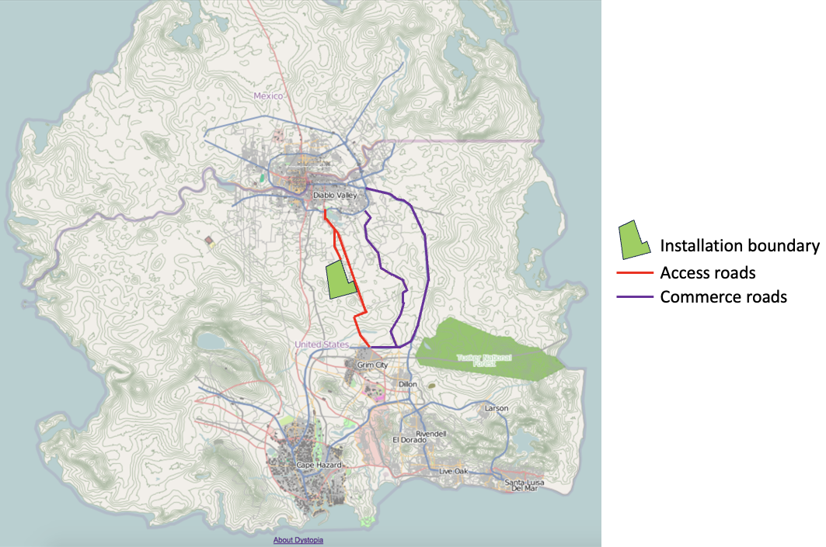
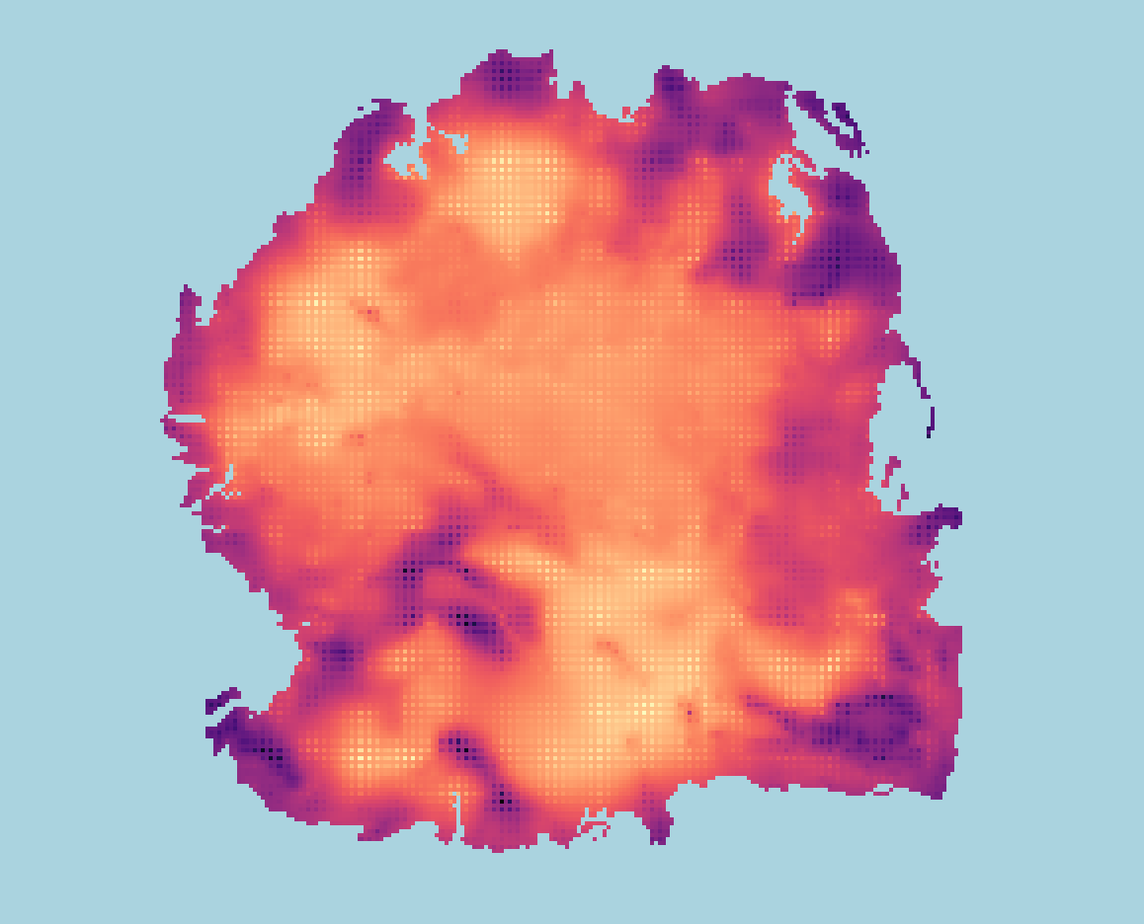

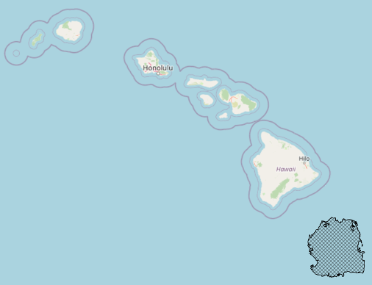

We have developed a sandbox-style virtual world suitable for supporting infrastructure analyses, experiments, and exercises
Dystopia Virtual World
Combines geographic and functional realism
A collection of structured data—realistic terrain, maps, population demographics, and infrastructure systems
military installations embedded in a broader community
can be relocated in any part of the world
Reference: Alderson, D.L. and Darken, R.P., 2019, Dystopia: A Virtual Environment for Education, Training, and Exercises, Naval Postgraduate School Technical Report NPS-OR-19-002, December.
17

Slide 18
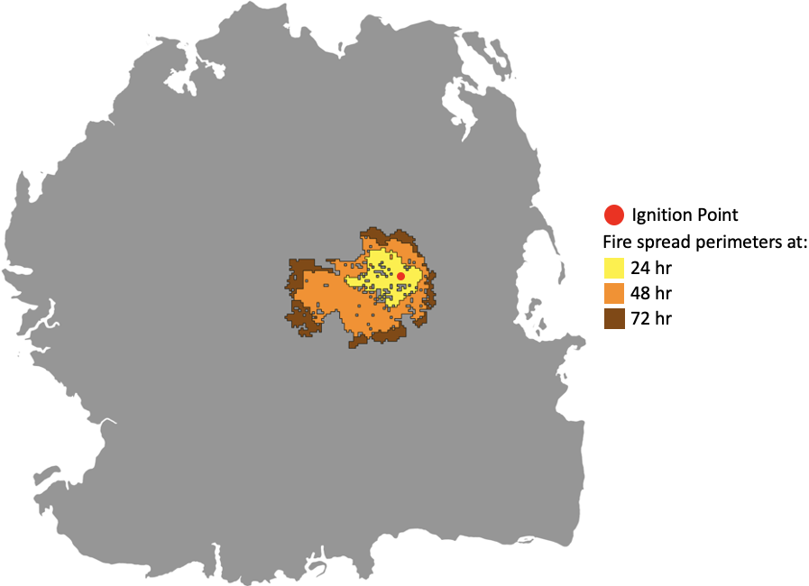
We have developed a sandbox-style virtual world suitable for supporting infrastructure analyses, experiments, and exercises
Dystopia Virtual World
Example: simulating wildfire risk to military installations on a fictitious “Hawaiian island”
Combines geographic and functional realism
A collection of structured data—realistic terrain, maps, population demographics, and infrastructure systems
military installations embedded in a broader community
can be relocated in any part of the world
9.4% - 16.8% intersect installation
10.6% - 19.9% intersect access roads
14.5% - 25.9% intersect commerce roads
Reference: USMC Maj. Nick Hardesty, “Modeling of Physically-Based Predictive Fire Events in a Virtual Environment from Geospecific Data” M.S. Thesis in CS, NPS, Sept. 2023.
18

Slide 19
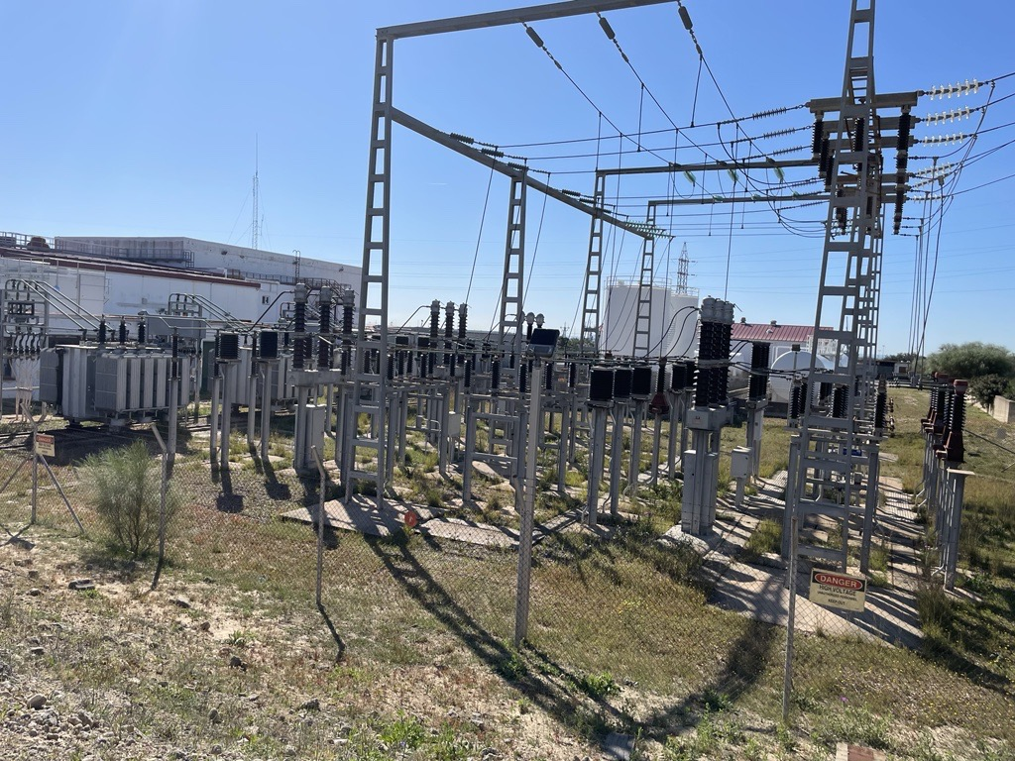
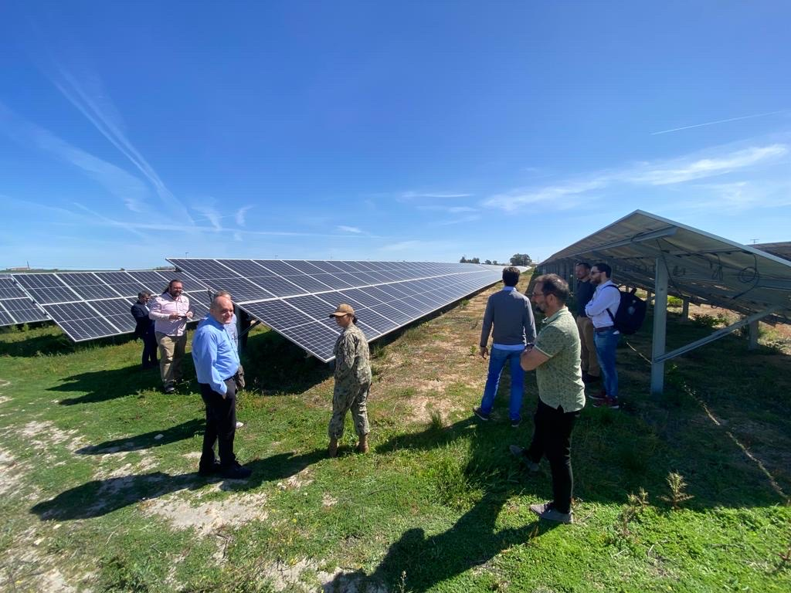
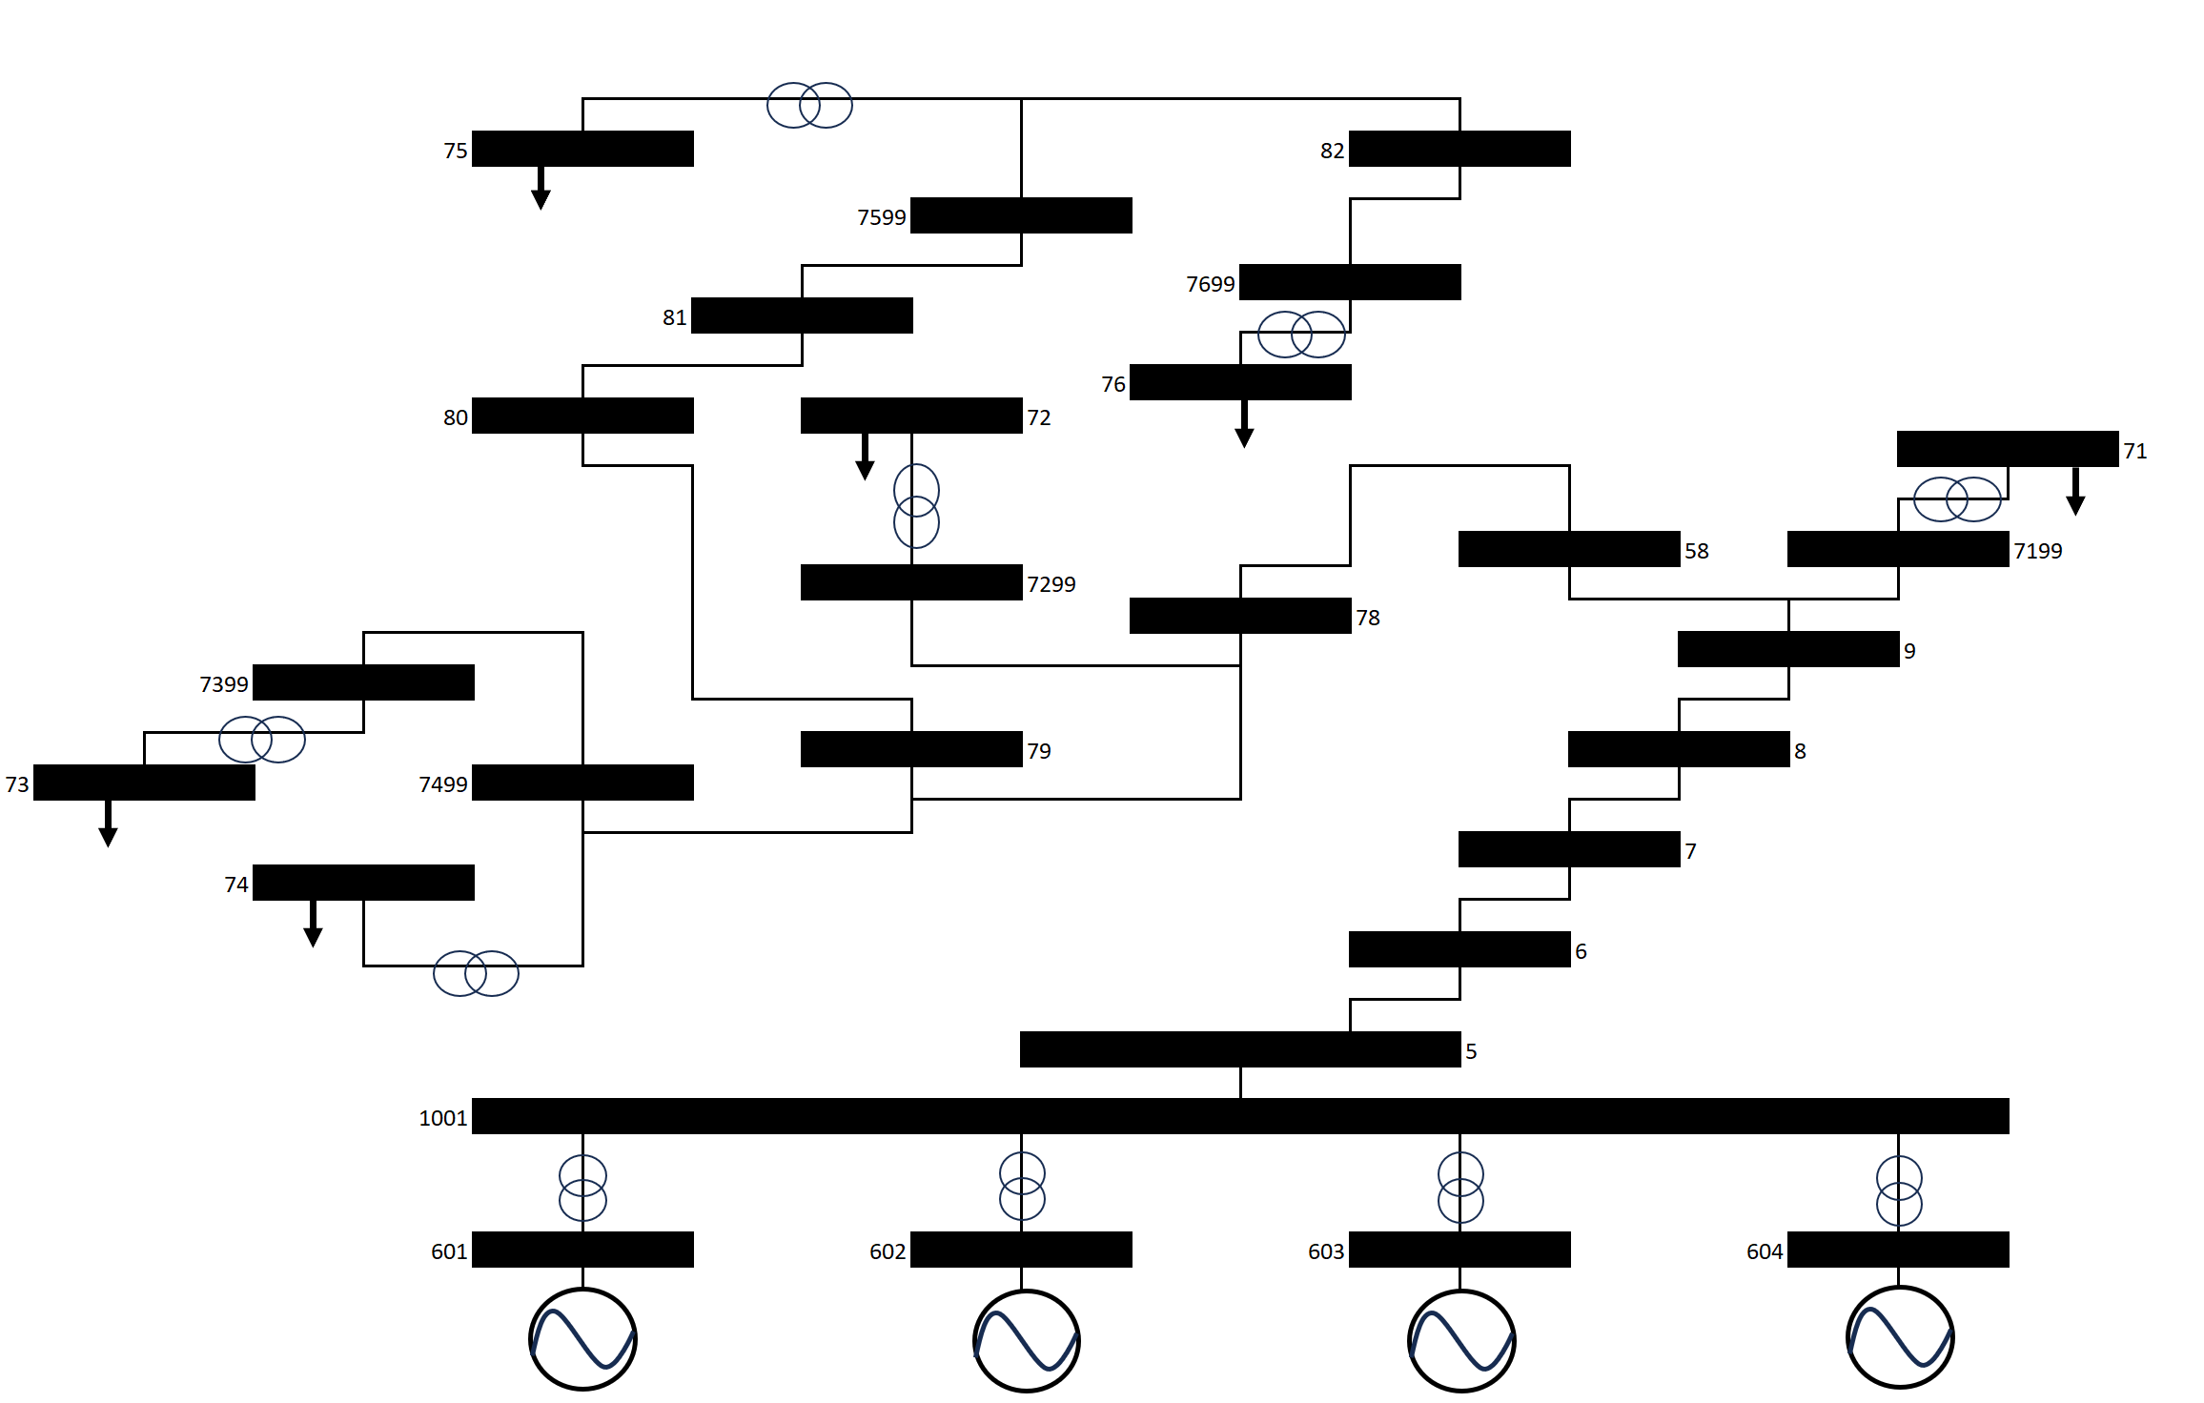
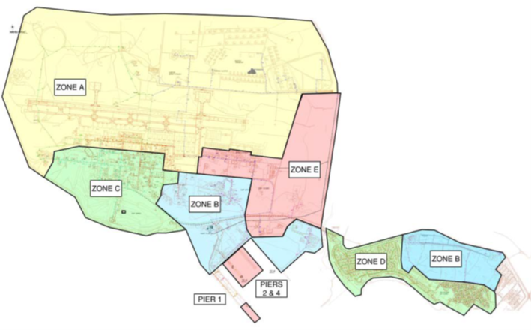
LCDR Olive Oliveros, “Power System Benchmarks for Infrastructure in Naval Installations” M.S. Thesis in Operations Research, NPS, Sept. 2023*
Objective:
Develop a power system benchmark that represents naval installations and can be publicly distributed in commercial software and the virtual environment, Dystopia
Use existing power demand data from naval installations to represent realistic characteristics of naval bases
Naval Station Rota Substation
Naval Station Rota Photovoltaic Farm
Notional Feeder 15 Bus Diagram
Naval Station Rota
defined into utility zone types
19

Slide 20
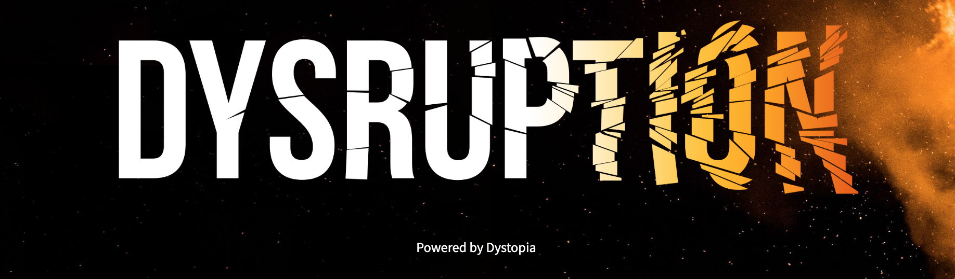
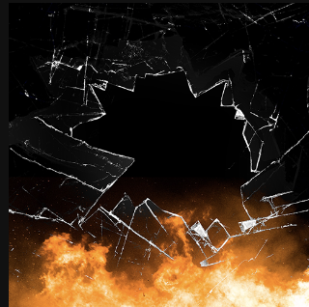

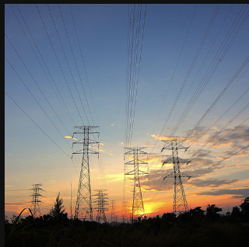
Dysruption: The Game
Break It Bad
Fix It Fast
Save Our System
Attack-based exploration of system dependence and vulnerability
Repair broken components to restore function under time pressure
Repair or replace to fix random failures under time and budget pressure
20

Slide 21
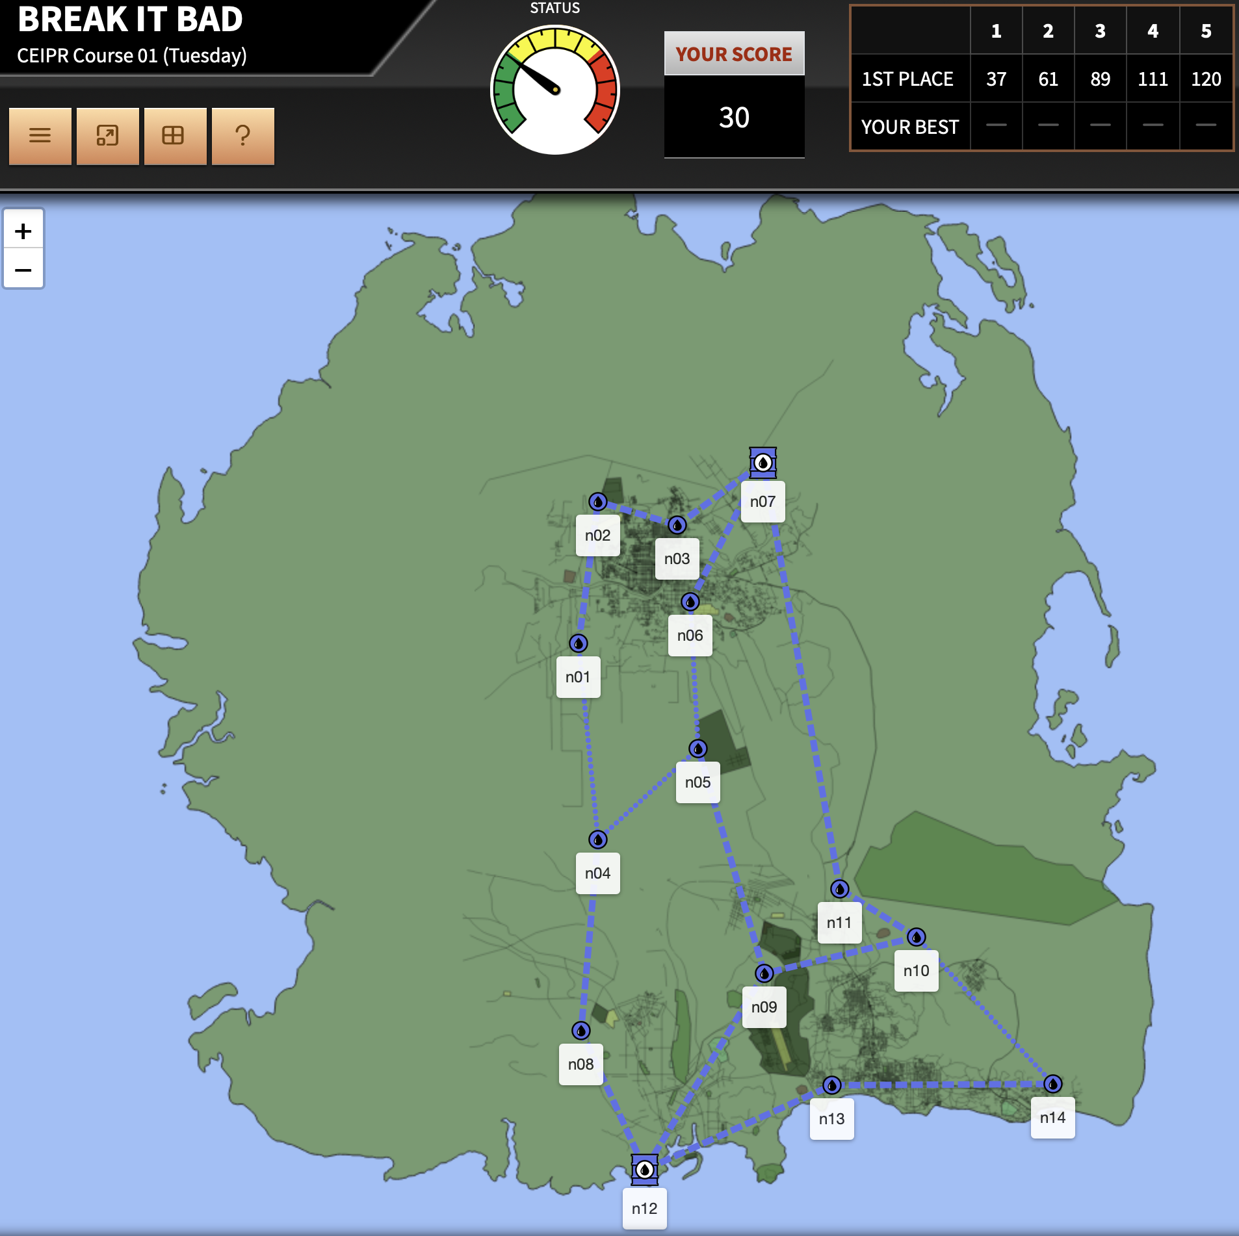
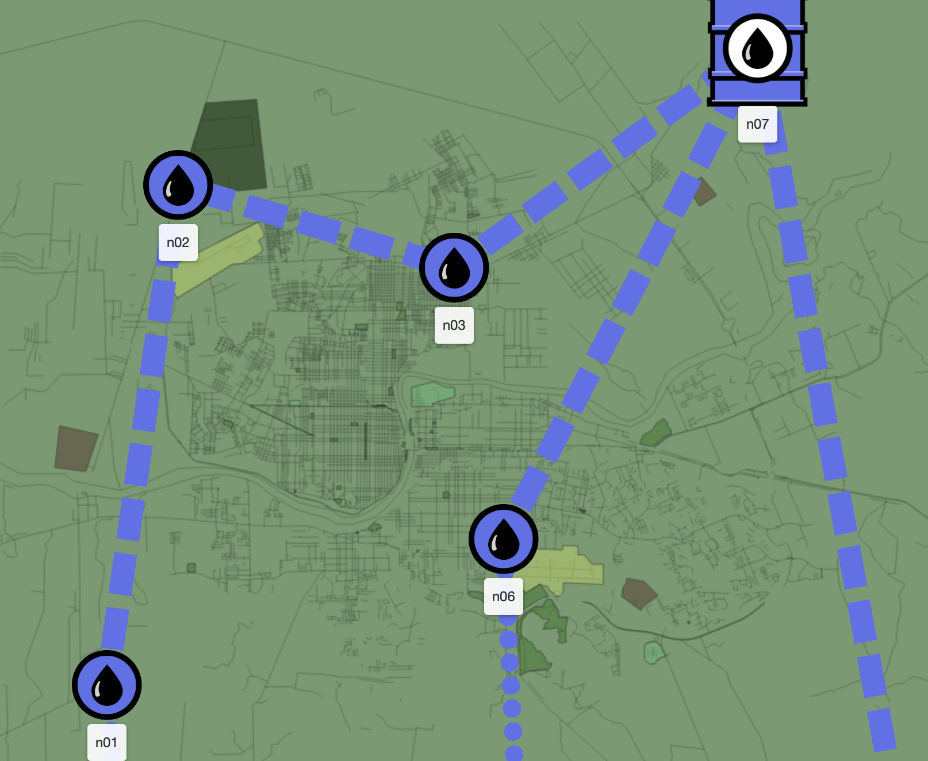
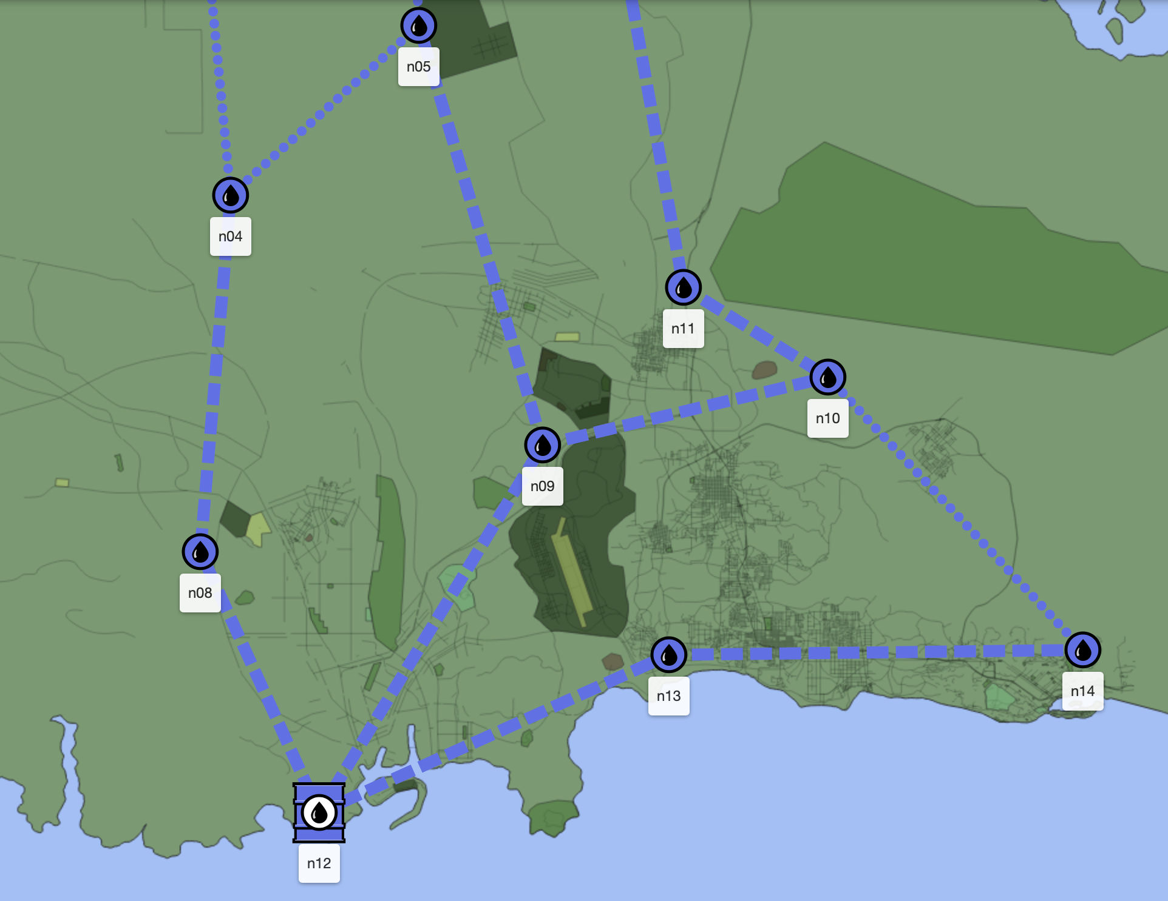
Dysruption Game: A notional fuel network
New components start at FCI=100.
The older the pipe segment, the lower the FCI.
Game 3: Save Our System
Nominal aging
(normal wear and tear, preventive maintenance, normal environmental conditions, etc.)
Facility Condition Index (FCI)
Accelerated aging (overuse, deferred maintenance,
unanticipated environmental exposure)
Component Age (# turns)
The lower the FCI, the higher the Prob{Failure}.
P(Fail | FCI=100) = 8.2%
P(Fail | FCI=97) = 8.8%
P(Fail | FCI=80) = 13.5%
Repair? Replace? Maintain? Budget and time constraints!
Facility Condition Index (FCI)
21

Slide 22
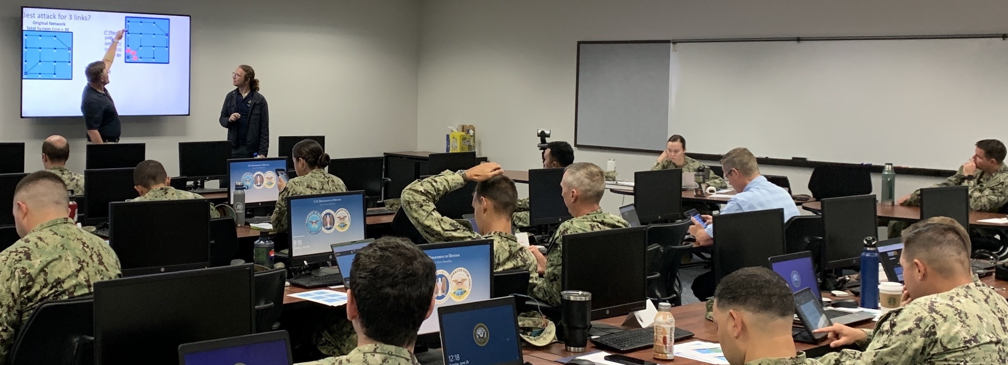
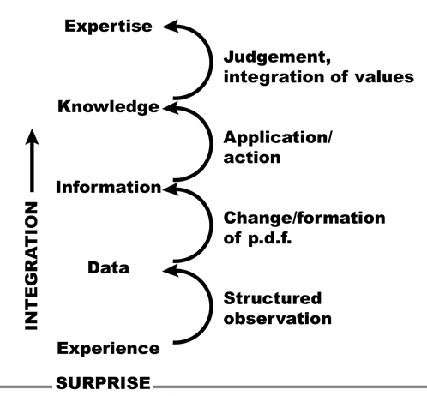



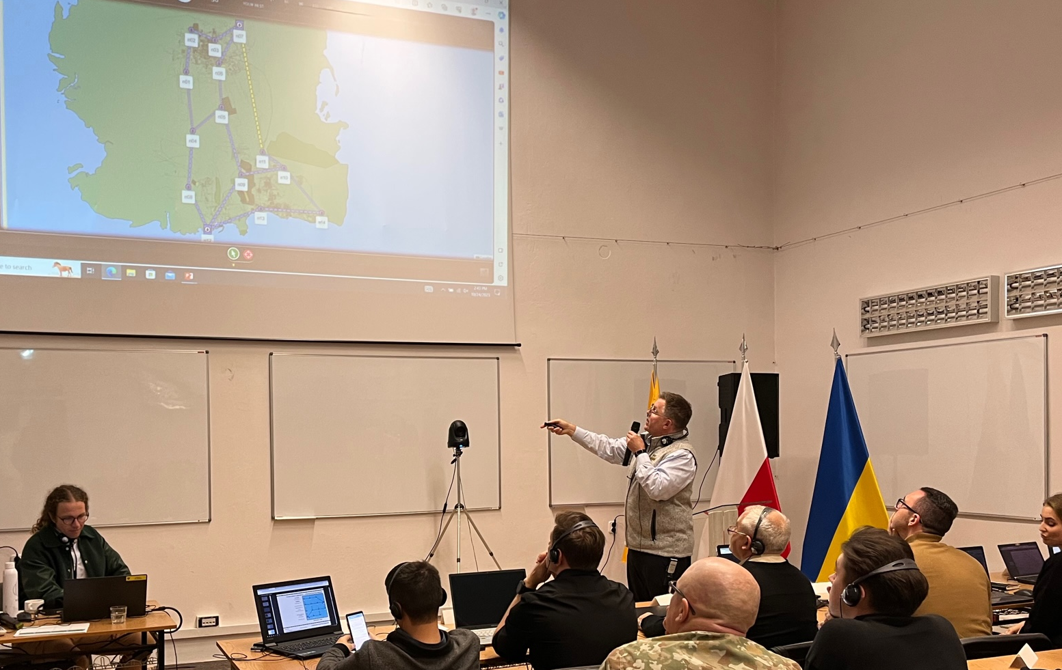

Training & Education
We have held 18+ Dysruption training sessions
NAVFAC Civil Engineering Corps Officer School (CECOS)
June 2022: CECOS Intermediate Public Works Department (PWD) Course
(Port Hueneme, CA)
Oct 2023: NATO LITPOLUKR Brigade Critical Energy Infrastructure Protection & Resilience Short Course for Ukraine
(Lublin, Poland)
22

Slide 23
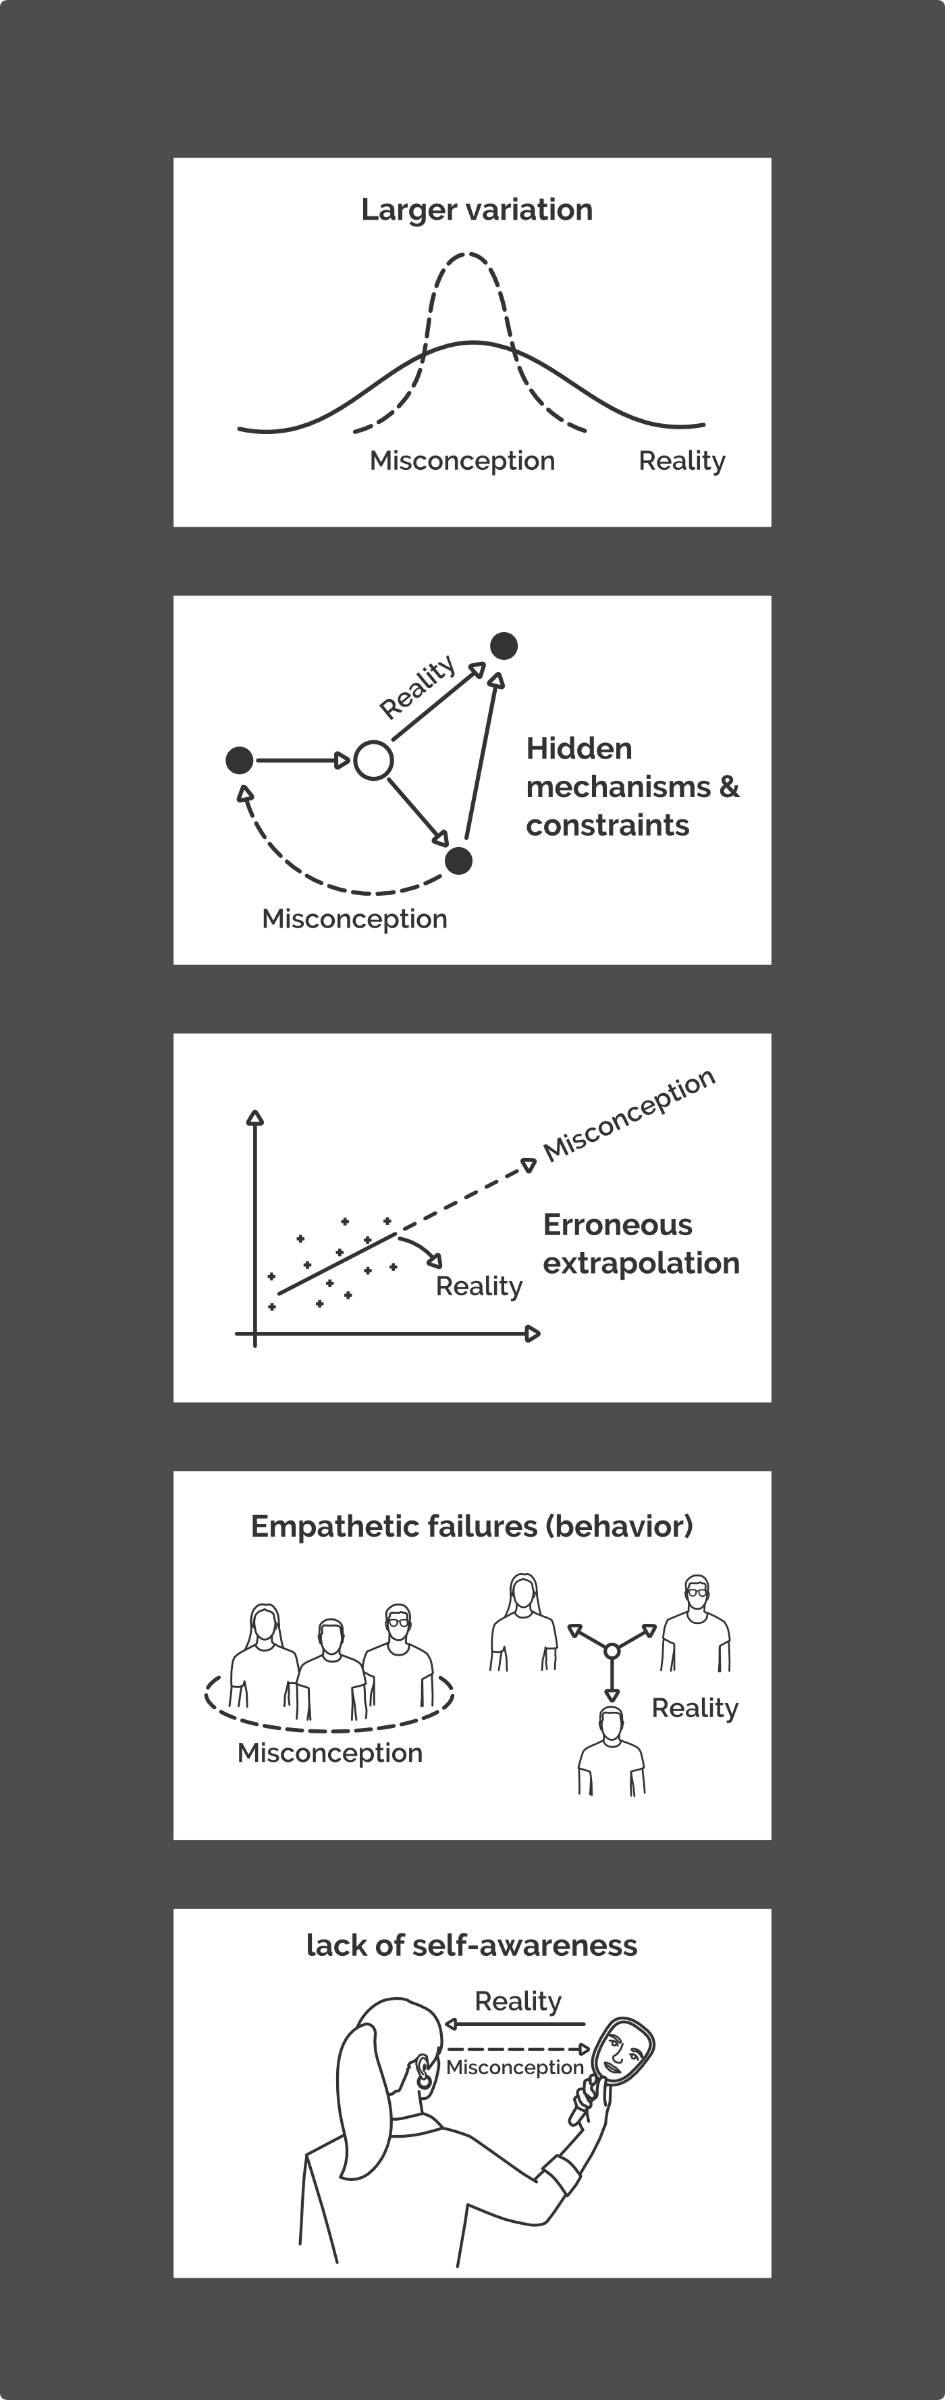
Training techniques, exercises, and experiences to accelerate development of expertise for adaptive response to surprise
How to create controlled conditions of surprise?
Surprise takes place when
experience breaks from expectation
Five Sources of Surprise
23
Notes:
Models and simulations require relatively little expense, but they are unable to explore much beyond the normal variation of events that have been conceived in the model.
To date, there is little beyond real events that reveal fundamental surprise.
Games and exercises involving human participants have the potential to train for situational surprise.
The current literature on surprise is fragmented.
There is a need for a more comprehensive taxonomy of misconceptions that make one vulnerable to surprise, if only so that we can better guard against it.

Slide 24
Key Messages
Surprise is inevitable – how can we be “prepared to be unprepared” ?
There is a need for a new theory of surprise
one that is connected to a deeper understanding of resilience
and focuses on processes not outcomes
New opportunities for novel exercises and training
Dystopia – a sandbox for studying infrastructure in context
Ongoing work: connecting to climate surprise in game play
24

Slide 25
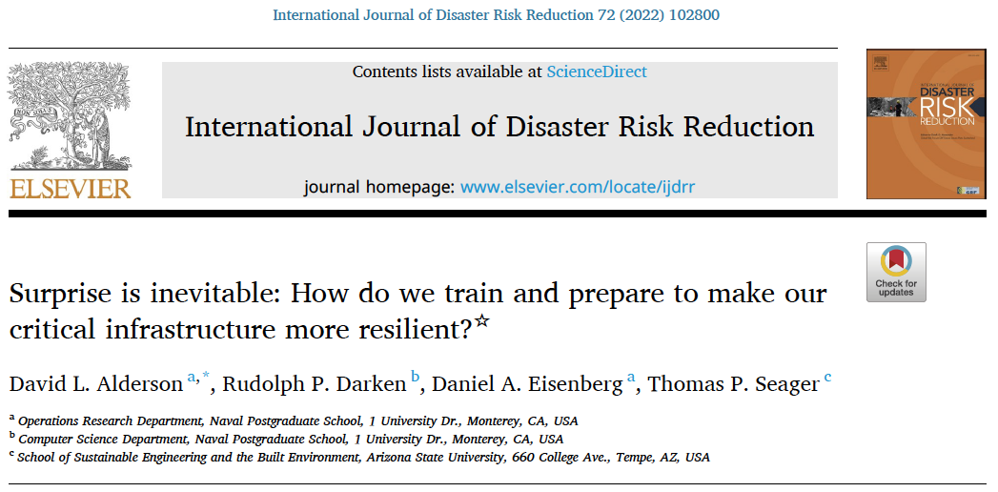
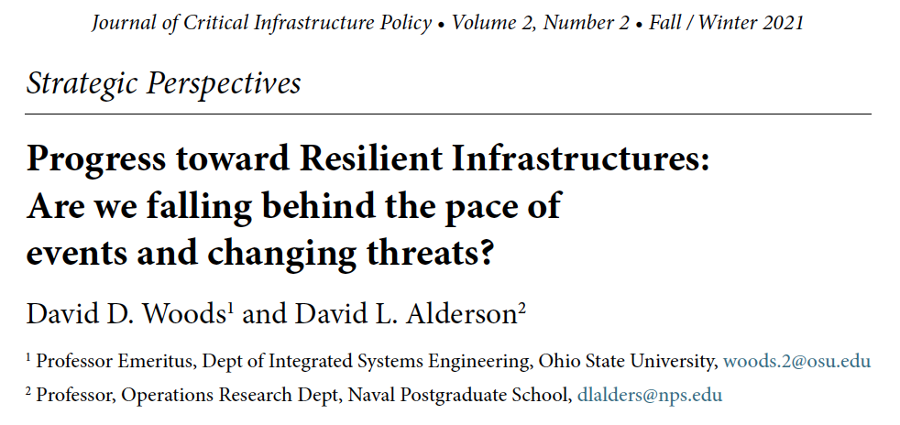
References
Thank you for listening!
David Alderson (dlalders@nps.edu)
Center for Infrastructure Defense
Operations Research Department
Naval Postgraduate School
https://www.nps.edu/web/cid/
25

